Slide 1
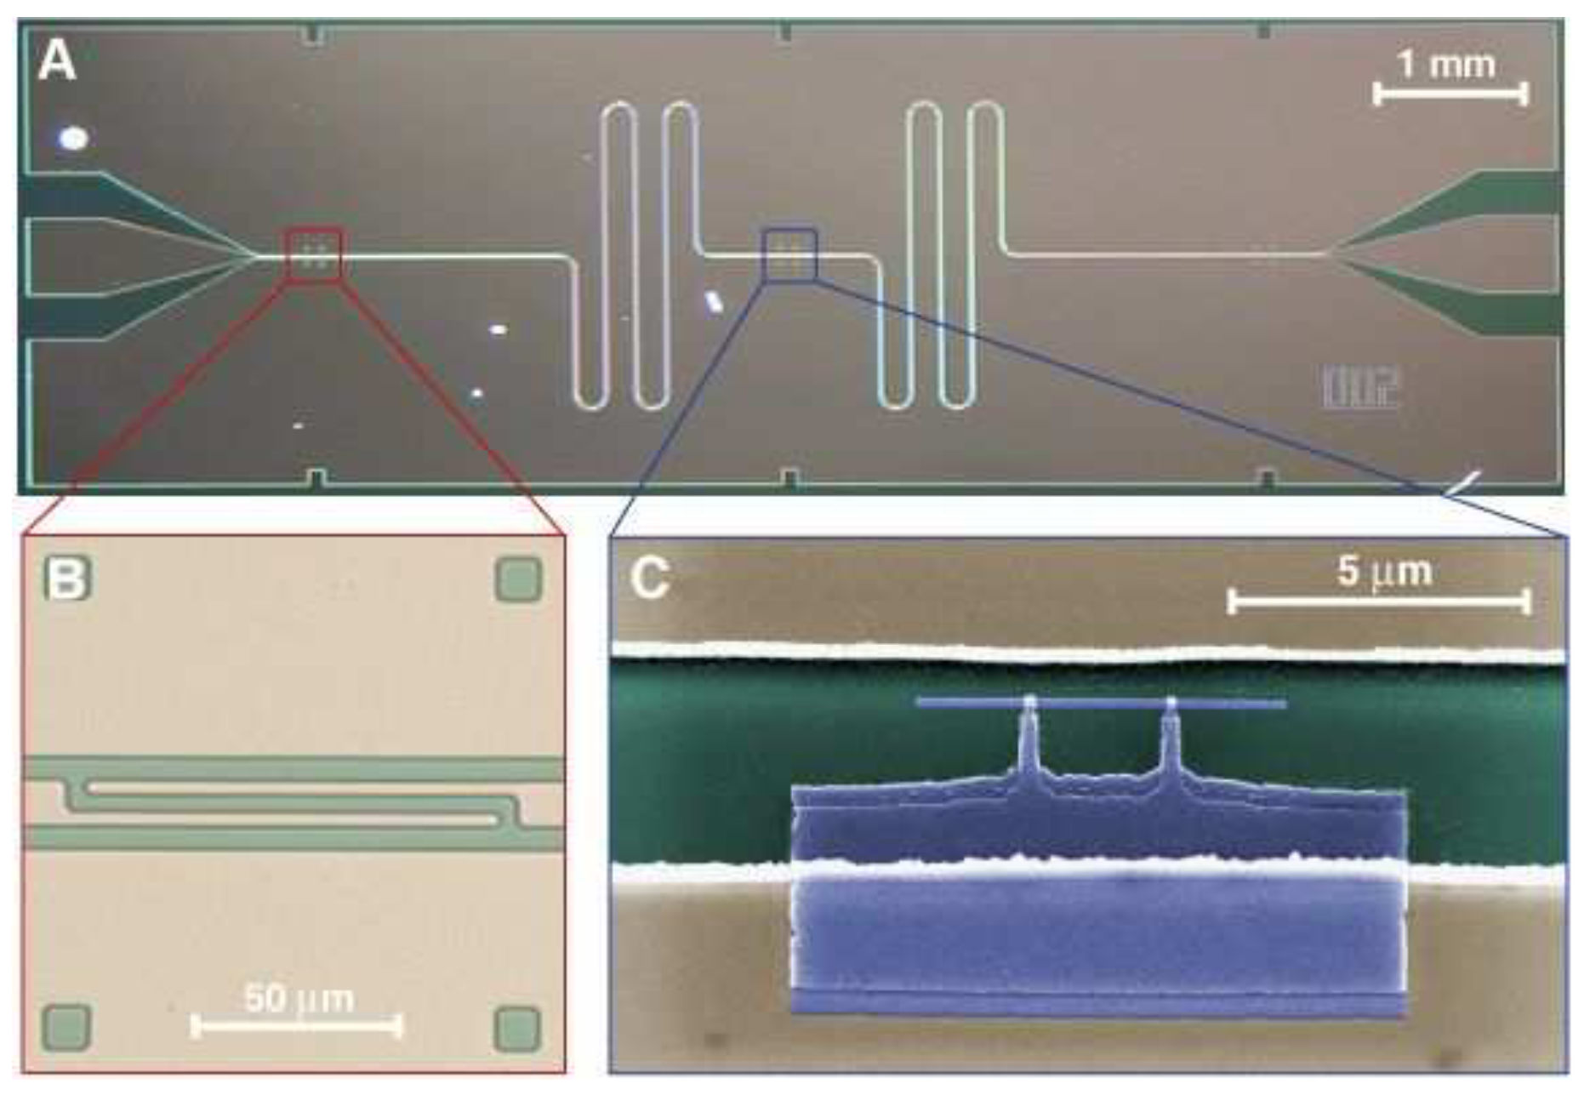
Strong coupling between CPW resonator and qubit
1)Decoherence effects (dephasing rate, spontaneous decay of the excited state) prevent coherent time evolution of the qubit states => the qubit alone is not suited for computation.
2)Losses in CPW resonators (coupling to external in/out line, dieletric losses) result in decay of the field mode
=> If the coupling strength between the resonator and the qubit exceeds the decay rates times => coherent oscillations => coherent qubit control
=>Strong coupling require high vacuum electric field E0 of the resonator and high electric dipole moment of the qubit.
Circuit Quantum Electrodynamics: Coherent Coupling of a Single Photon to a Cooper Pair Box
A. Wallraff, D. I. Schuster, A. Blais, L. Frunzio, R.-S. Huang, J. Majer, S. Kumar, S. M. Girvin, R. J. Schoelkopf

Slide 2
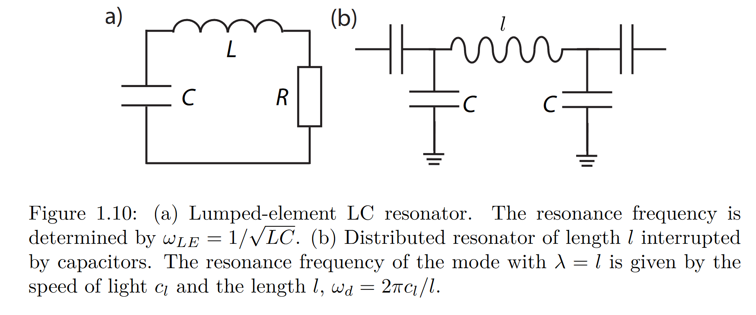
Requirements on resonator properties
High E0 is given by using a distributed element construction resonator (low stray capacitances and inductances) with low lateral size scales : CPW resonator
Characteristics of CPW resonator:
Well defined resonance frequency
High Q_{int}
Q_{ext} depending on the application:
-> Low: fast measurements on the qubit
-> High: store photons for quantum memory
Forn-Diaz, Pol. (2010). Superconducting Qubits and Quantum Resonators.

Slide 3
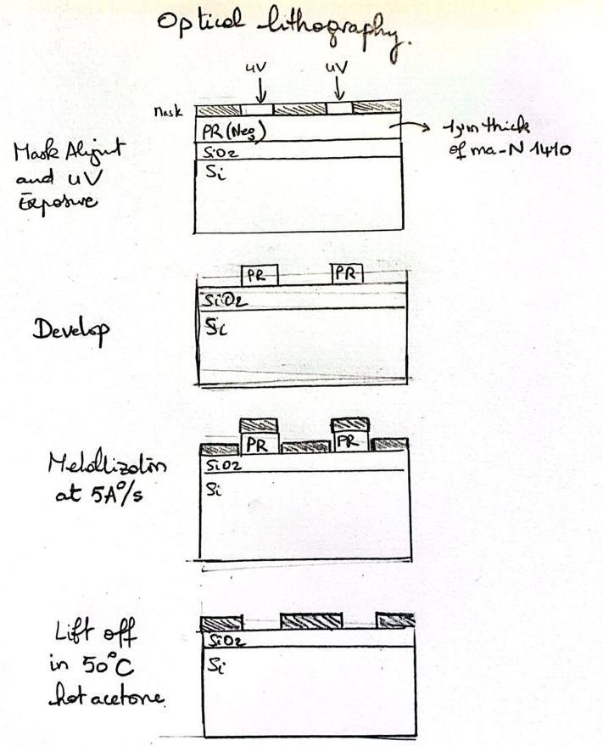
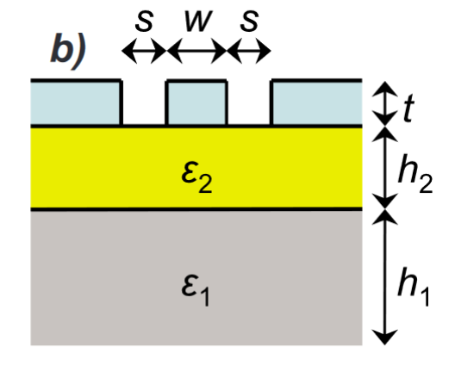
CPW resonator geometry and fabrication
Gap
s=6.6um
Center conductor
w=10um
Lateral ground planes
Aluminium Metallization
t=200nm
SiO2 layer with thermal oxydation
h2=550nm e2=3.78
Undoped (100)-oriented Si substrate
h1=500um e1=11.6
J. Appl. Phys. 104, 113904 (2008)© 2008 American Institute of Physics. Coplanar waveguide resonators for circuit quantum electrodynamics

Slide 4
CPW resonator geometry and fabrication
1) Bulk resistivity of Si substrate determined at room temperature with Van Der Paw measurements
2) SiO2 layer thickness measured by SEM inspection
3) SEM inspection after dicing to verify the degree of control over fabrication processes
4) S21 transmission measured with 40GHz VNA in pulse tube based dilution refrigerator system at 20mK
J. Appl. Phys. 104, 113904 (2008)© 2008 American Institute of Physics. Coplanar waveguide resonators for circuit quantum electrodynamics

Slide 5
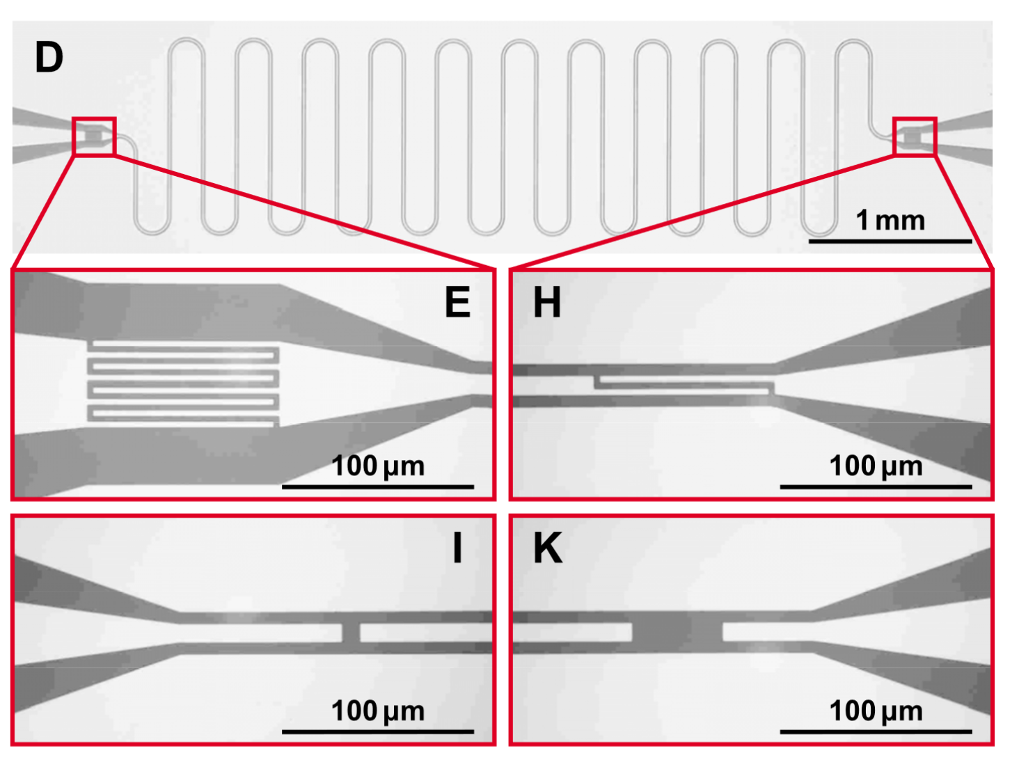
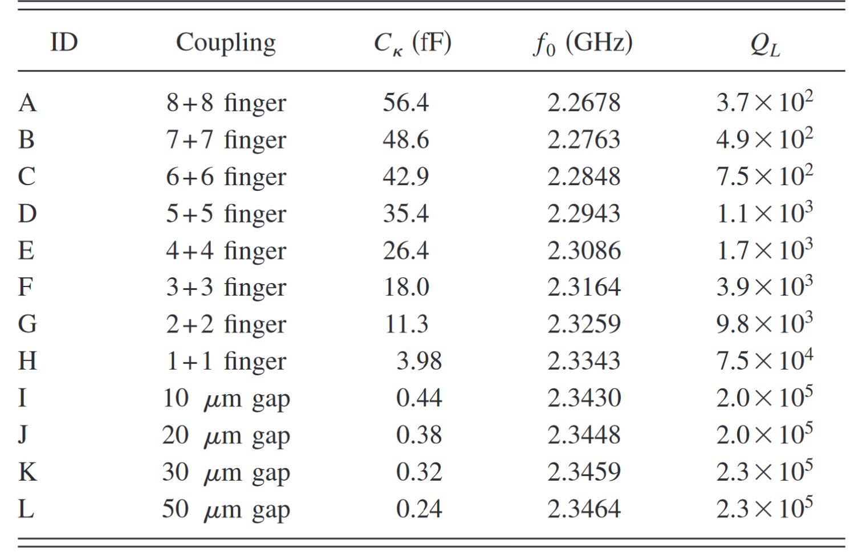
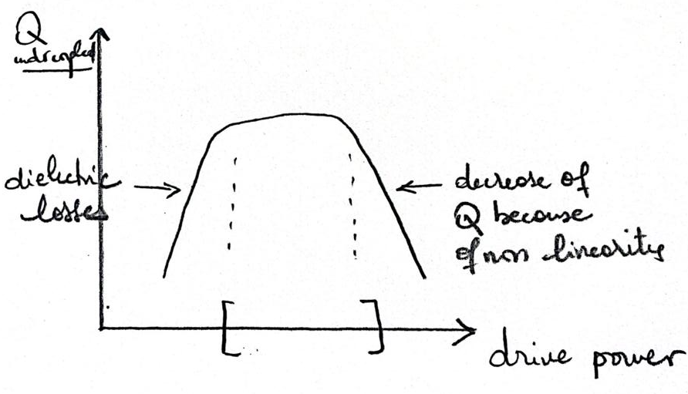
CPW resonator external coupling
Gap capacitance : (I, K)
Undercoupled Qint<Qext
High Ql: Need for 32dB gain HEMT and 35dB gain TAmplifiers
Finger capacitance: (E, H)
Overcoupled Qint>Qext
Low Ql: Need for 32dB gain HEMT and 35dB gain TAmplifiers
J. Appl. Phys. 104, 113904 (2008)© 2008 American Institute of Physics. Coplanar waveguide resonators for circuit quantum electrodynamics

Slide 6
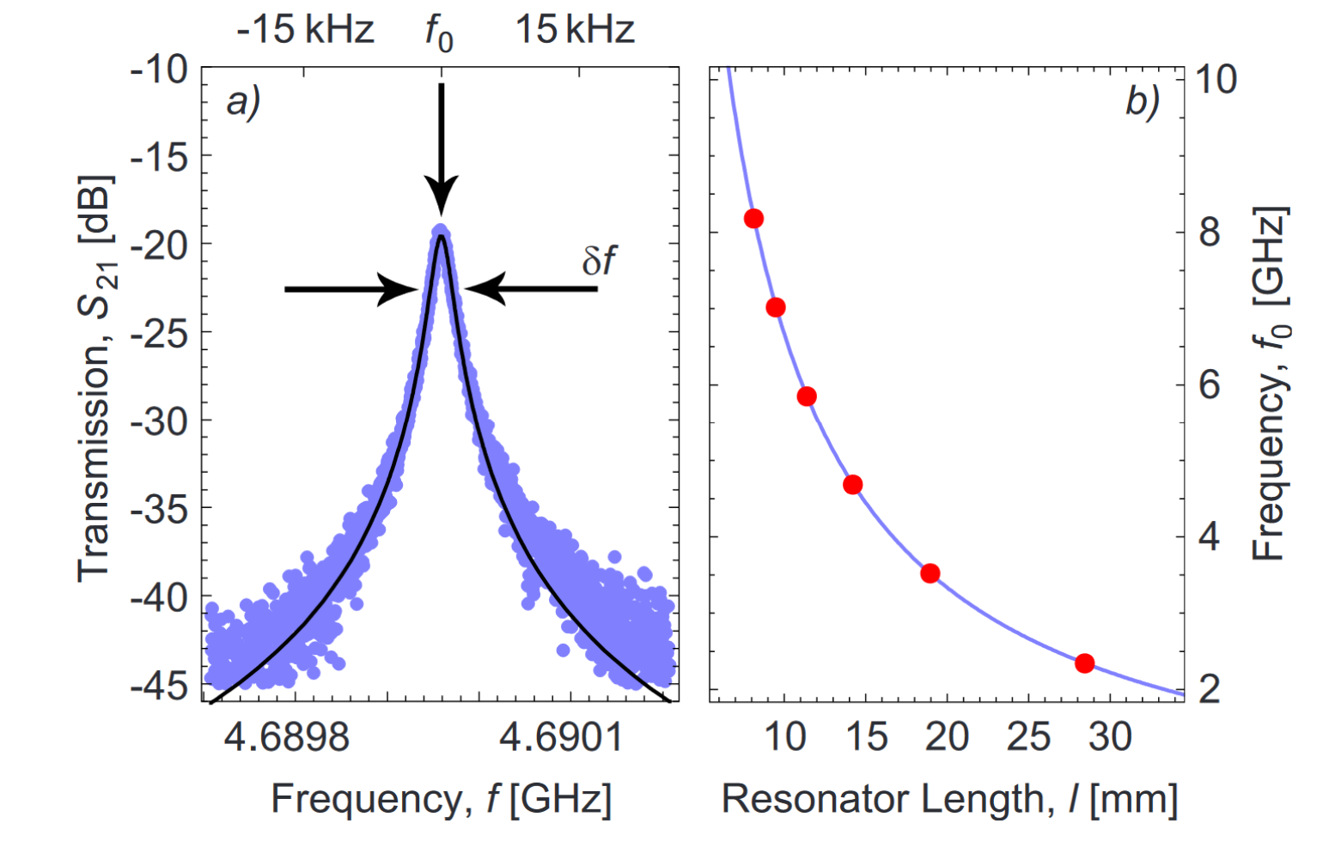
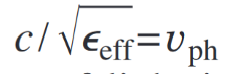
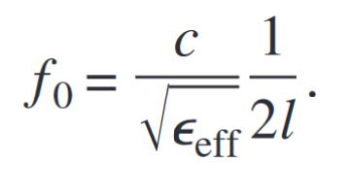
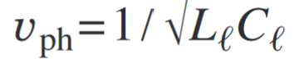
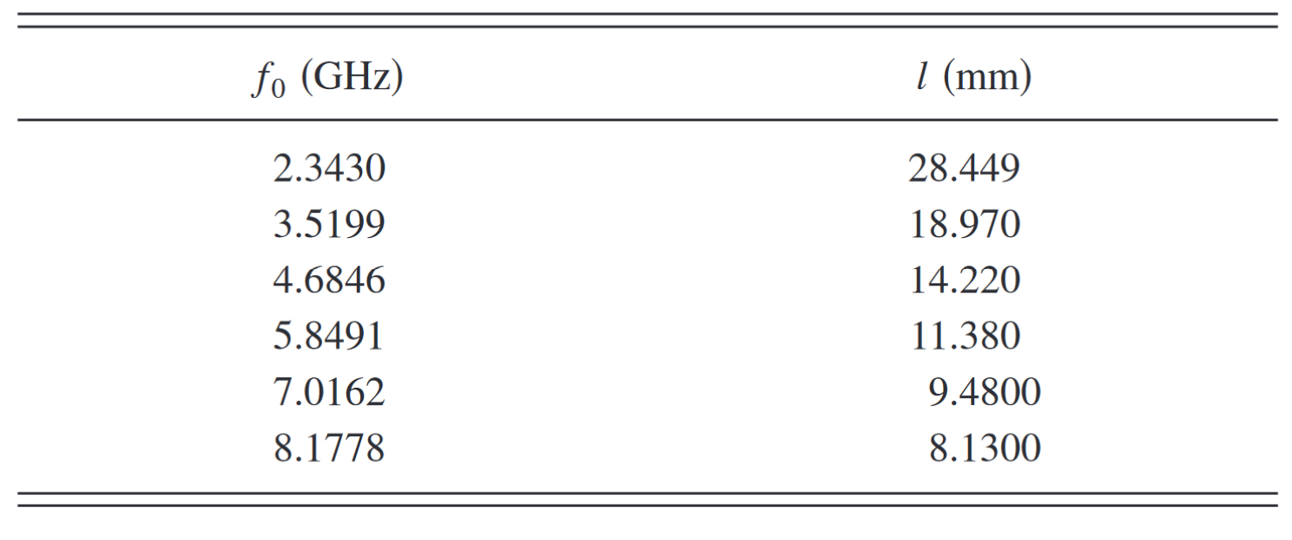
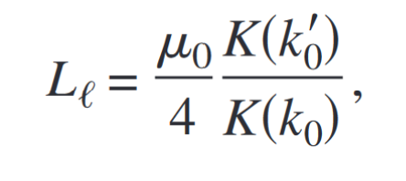
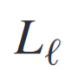
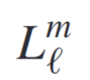
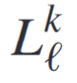
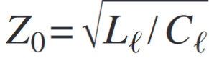
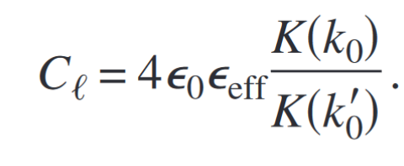

CPW resonator properties
Resonance frequency:
+
50 Ohms characteristic impedence for transmission lines of radiofrequency signals
minimum loss
maximum power
maximum voltage for transmission lines of radiofrequency signals
Inertia to move copper pairs not negligeable
=> large carrier relaxation time
=> Scales with the square of the London penetration depth
Conformal mapping : provide analytical expression ɛff for double layer substrates
FEM => ɛff = 5.22
J. Appl. Phys. 104, 113904 (2008)© 2008 American Institute of Physics. Coplanar waveguide resonators for circuit quantum electrodynamics

Slide 7
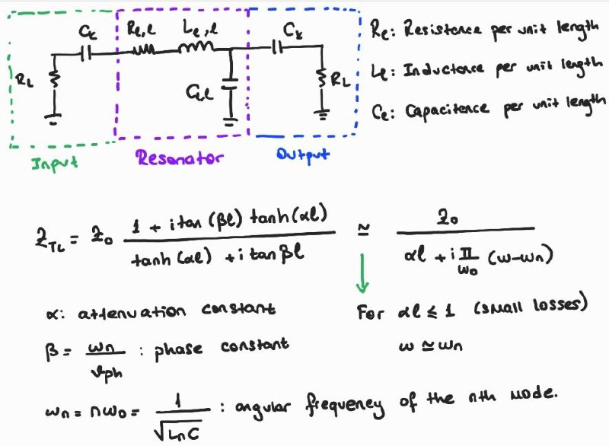
Input/Output Coupling
Notes:
-A TL resonator is a distributed device with voltages and currents varying in magnitude and phase over its LENGTH.
-Around resonance, the properties of a TL resonator can be approximated to parallel LCR oscillator

Slide 8
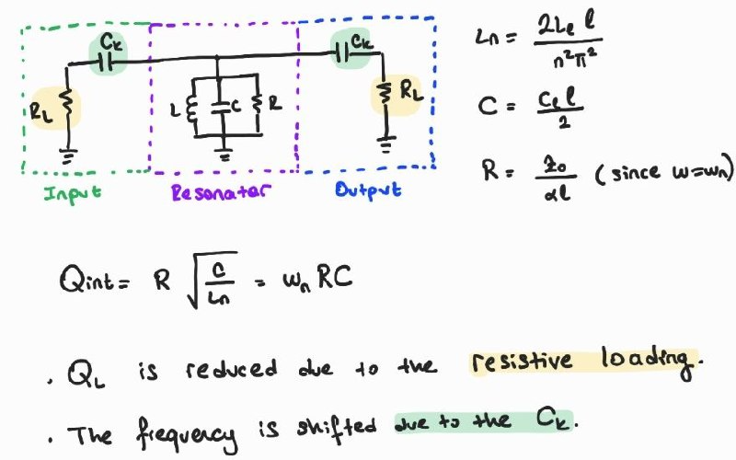
Notes:
-To understand this effect the series connection the series connection of Ck and RL can be transformed into a Norton equivalent.

Slide 9
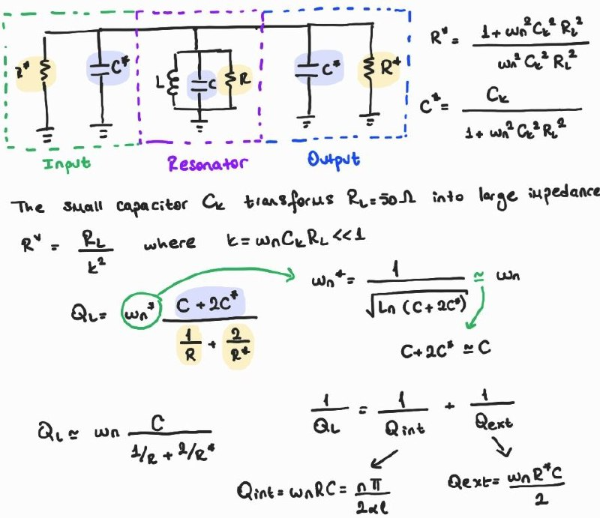

Slide 10
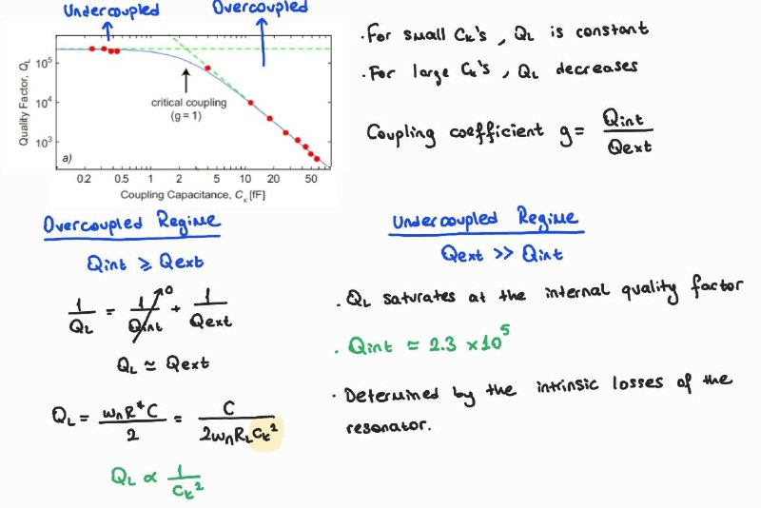
Notes:
Qint is limited by the dielectric losses since radiation losses are expected to be small in CPW resonators.
Also, resistive losses are negligible under Tc of the superconductor.

Slide 11
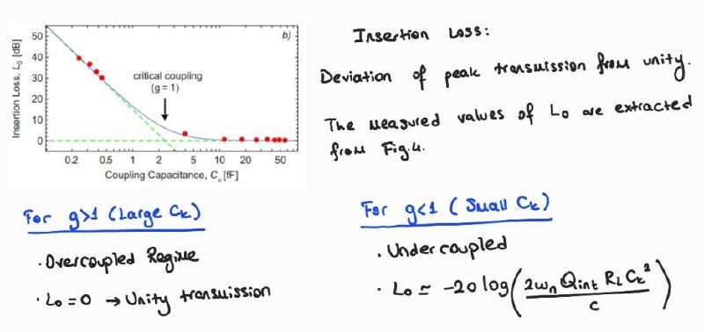

Slide 12
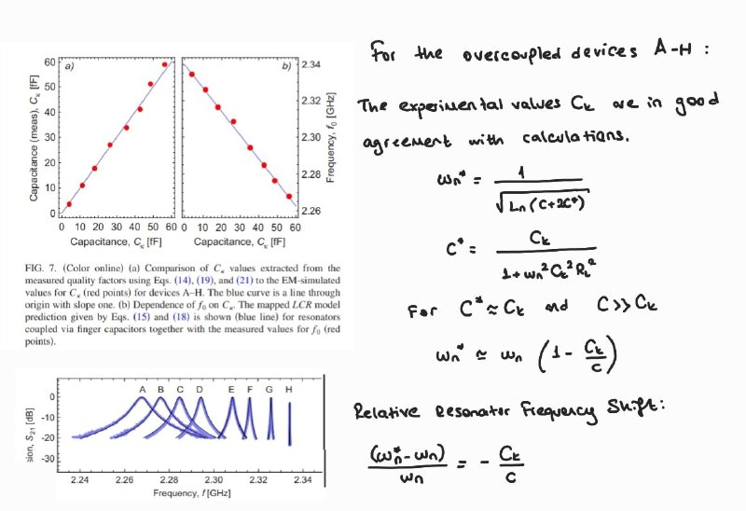

Slide 13
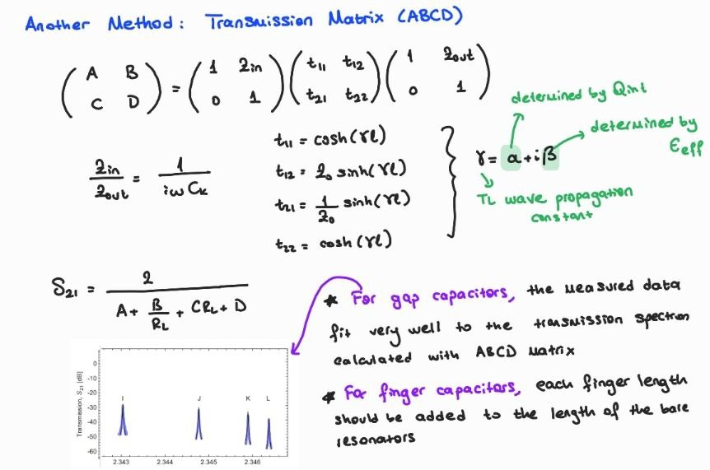

Slide 14
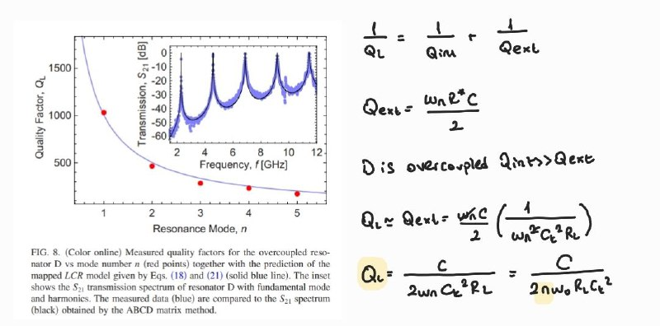
Harmonic Modes

